Slide 1
EMBEDDED SYSTEMS
AIWA THOMAS (7)
ADWAID MK (5)
ARJUN PRASAD (15)
GOUTHAM PANKAN SUDHIR (22)
RITHIL U (44)
VYSHNAV KARIMBIL (56)

Slide 2
CONTENTS
Introduction
What is an Embedded System
Classification of Embedded System
Applications of Embedded Systems
Implementation
Conclusion

Slide 3
Introduction
Embedded Systems are combination of hardware and software that are designed to do a specific function or functions.
You may also think of an embedded system as a controller that’s part of a larger design
Let’s know more about Embedded Systems in the upcoming slides

Slide 4
What is an Embedded System?
An embedded system is a computer system—a combination of a computer processor, computer memory, and input/output peripheral devices—that has a dedicated function within a larger mechanical or electrical system.
An embedded system is a combination of computer hardware and software, either fixed in capability or programmable, designed for a specific function or functions within a larger system.
Term Embedded reflects the fact that they are an integral part of the system

Slide 5
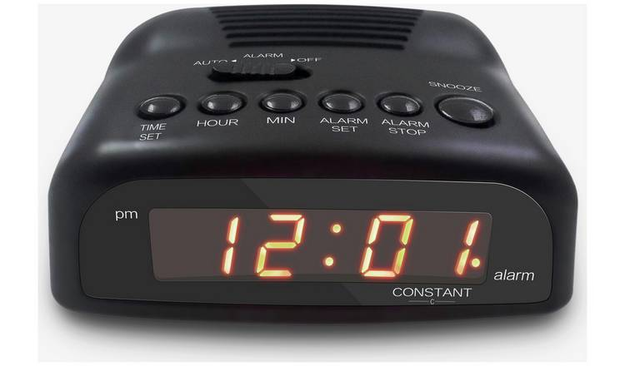
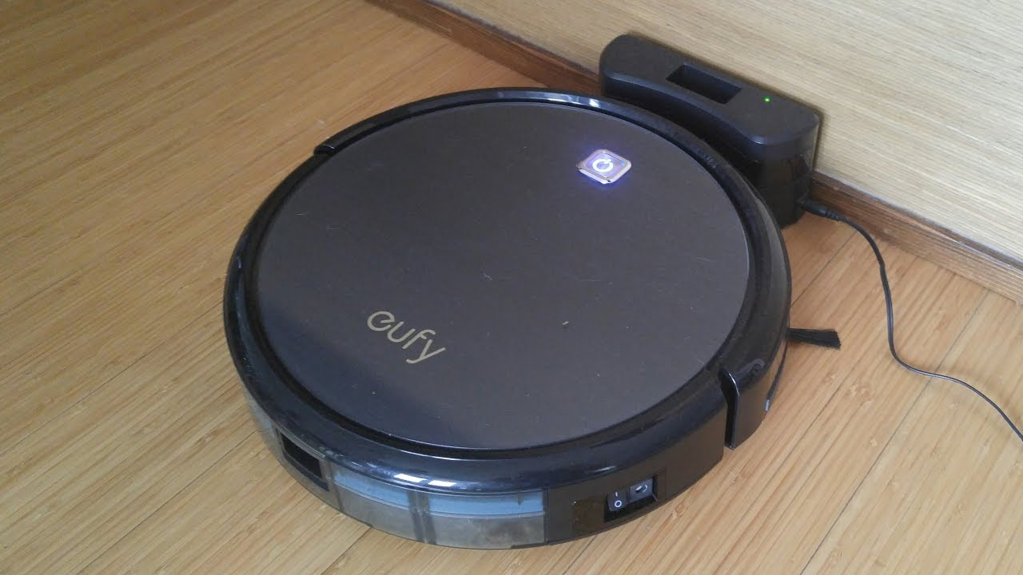
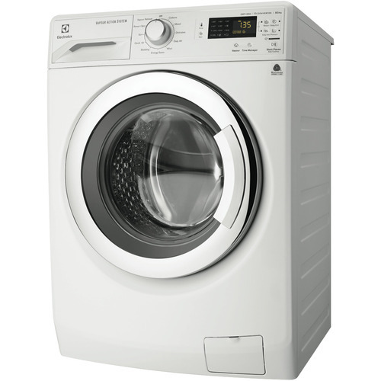
Inside of an Embedded System
Hardware
Software
CPU
MEMORY
I/O DEVICES
APPLICATION
OPERATING SYSTEM
DEVICE DRIVERS

Slide 6
CLASSIFICATION OF E.S
Embedded Systems
Based on performance and functional requirements
Real-Time
Stand Alone
Based on performance of microcontroller
Small Scale
Networked
Mobile
Medium Scale
Sophisticated

Slide 7
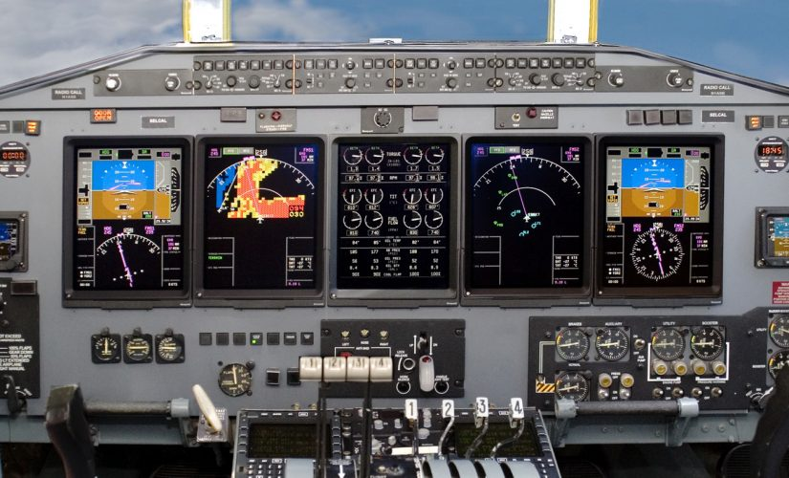

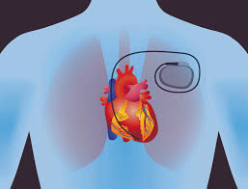
Real Time Embedded Systems
Real-time embedded systems are defined as those systems in which the correctness of the system not only depends on the logical results of computation, but also the time at which the results are produced.
Hard Real-Time Systems e.g., Avionic Control
Firm Real-Time Systems e.g., Banking
Soft Real-Time Systems e.g., Video on demand

Slide 8
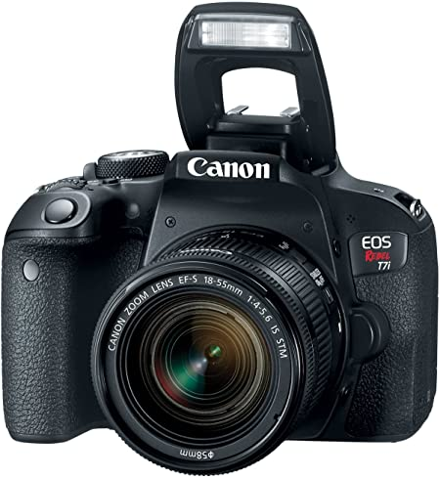
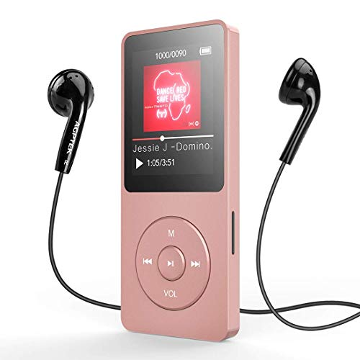
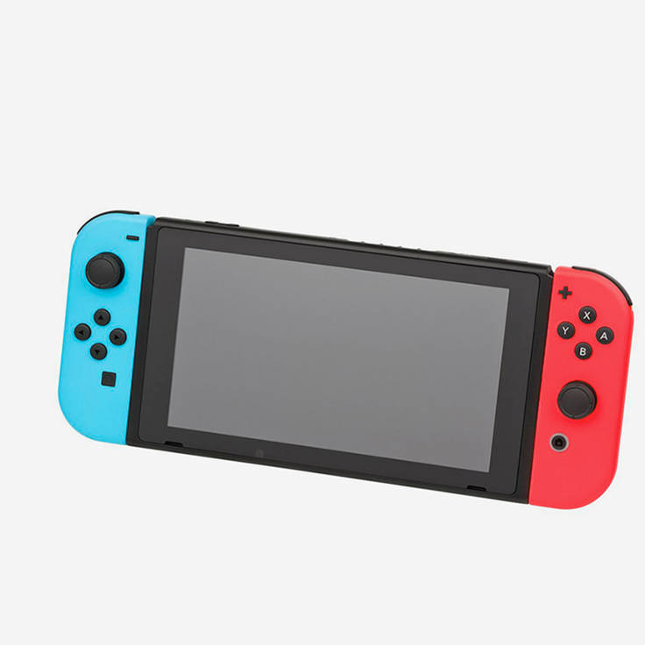
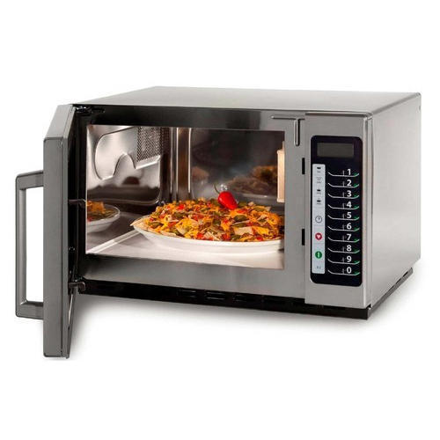
Stand Alone Embedded System
It is a system that works by itself, and does not need a host system like a computer.
It takes digital or analogs as inputs, and do some proccessing to them and outputs the data as it is attached to the output service.
E.g., Digital Camera, MP3 Player, Gaming Console, Microwave Oven

Slide 9
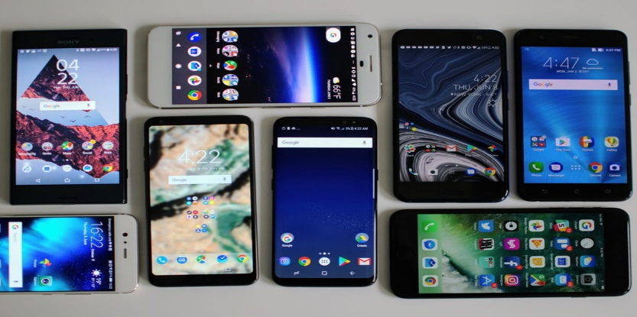

Networked Embedded System
These types of embedded systems are related to a network to access resources
Connected network can be LAN, WAN or the internet. The connection can be wired or wireless. This type of ES is the fastest growing area in embedded system applications
E.g., Home security system wherein all sensors are connected and run on the TCP/IP protocol
Mobile Embedded System
Mobile Embedded Systems are used in portable embedded devices like cell phones, mobiles, digital cameras, etc.
Basic limitation of these devices is memory limitations

Slide 10
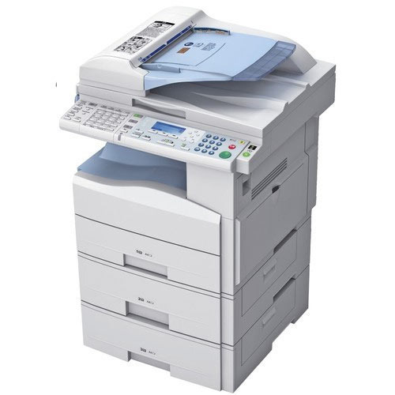
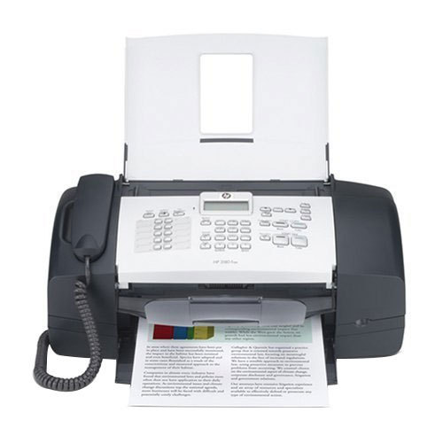
Small Scale Embedded Systems
Based of Performance of Microcontroller :-
Small-scale embedded systems are an entry-level system in which 8-bit or 16-bit processor is used. The processor has very limited resources like RAM, ROM and processing speed.
For the development of the small-scale embedded system, we need integrated development environment(IDE) for writing the code. The code is generally written in assembly language or in embedded C language. The compiler is needed if programming in embedded C. Compiler compiles the C code into the Hex code. We need assembler if we are coding in assembly language.
E.g., Washing Machine, Oven, CD Drive, Photocopy Machine, Fax Machine, Printer.

Slide 11
Medium Scale Embedded Systems
This type of embedded systems consisting of 16-bit or 32-bit microprocessor.
There are other options also available like Digital signal processor(DSP), or some Advanced RISC architecture machine. The medium scale embedded systems are generally faster than the small scale due to the number of bits of processor that give a better speed.
At the time of development, we need different types of software tools like assembler, compiler and debugger. An RTOS can be implemented on medium scale embedded systems.
Sophisticated Embedded Systems
This type of embedded systems is made to perform the complex functions.
The systems have hardware and software complexity. In this type of systems, the speed is measure concern. So some of the software functionality is implemented into the hardware. There are different modules are implemented on the CPU like TCP/IP, encryption, decryption, multiplier unit and more. Once the functionality is implemented into hardware the gives the better speed.
This type of systems have some key components like graphical user interface, communication ports like I2C, CAN, RS232, Ethernet or USB. You can see this type of system as network router, IP camera, embedded web server.

Slide 12
APPLICATIONS OF EMBEDDED SYSTEMS
Automobiles and Telecommunication
Motor and cruise control system
Body and Engine safety
Entertainment and multimedia in car
E-com and Mobile access
Robotics in assembly line
Wireless communication
Mobile computing and networking
Smart Cards, Missiles and Satellites
Security Systems
Telephone and Banking
Defense and Aerospace
Communication
Consumer Electronics
Digital Cameras
Set top Boxes
High Definition TVs
DVDs
Peripherals and Computer Networking
Displays and Monitors
Networking Systems
Image Processing
Network Cards and printers

Slide 13
How Do We Implement Them?
We do so by using microcontrollers or microprocessor based systems
Or simply by using digital circuits that perform the function we want
Digital Circuits are faster, but they are inflexible.
They have only propagation delay
The functions they perform cannot be changed easily
e.g., Communication system, ciphering algorithm
Microprocessor based systems are slower but flexible
Speed is technology dependent
We need only to update the software
E.g., Personal computing, PDA’s. Mobile Phones, PLC’s

Slide 14
CONCLUSION
Further more,
Embedded systems are rapidly becoming a catalyst for change in the computing, data communications, telecommunications, industrial control and entertainment sectors.
Automatic systems in any field will be useful and will save the people and organizations.
New innovative applications in these as well as other areas will make embedded systems as one of the fastest developing technology of the near future.
Thus the embedded system plays an important role in our day today life.

Slide 15


